Slide 1
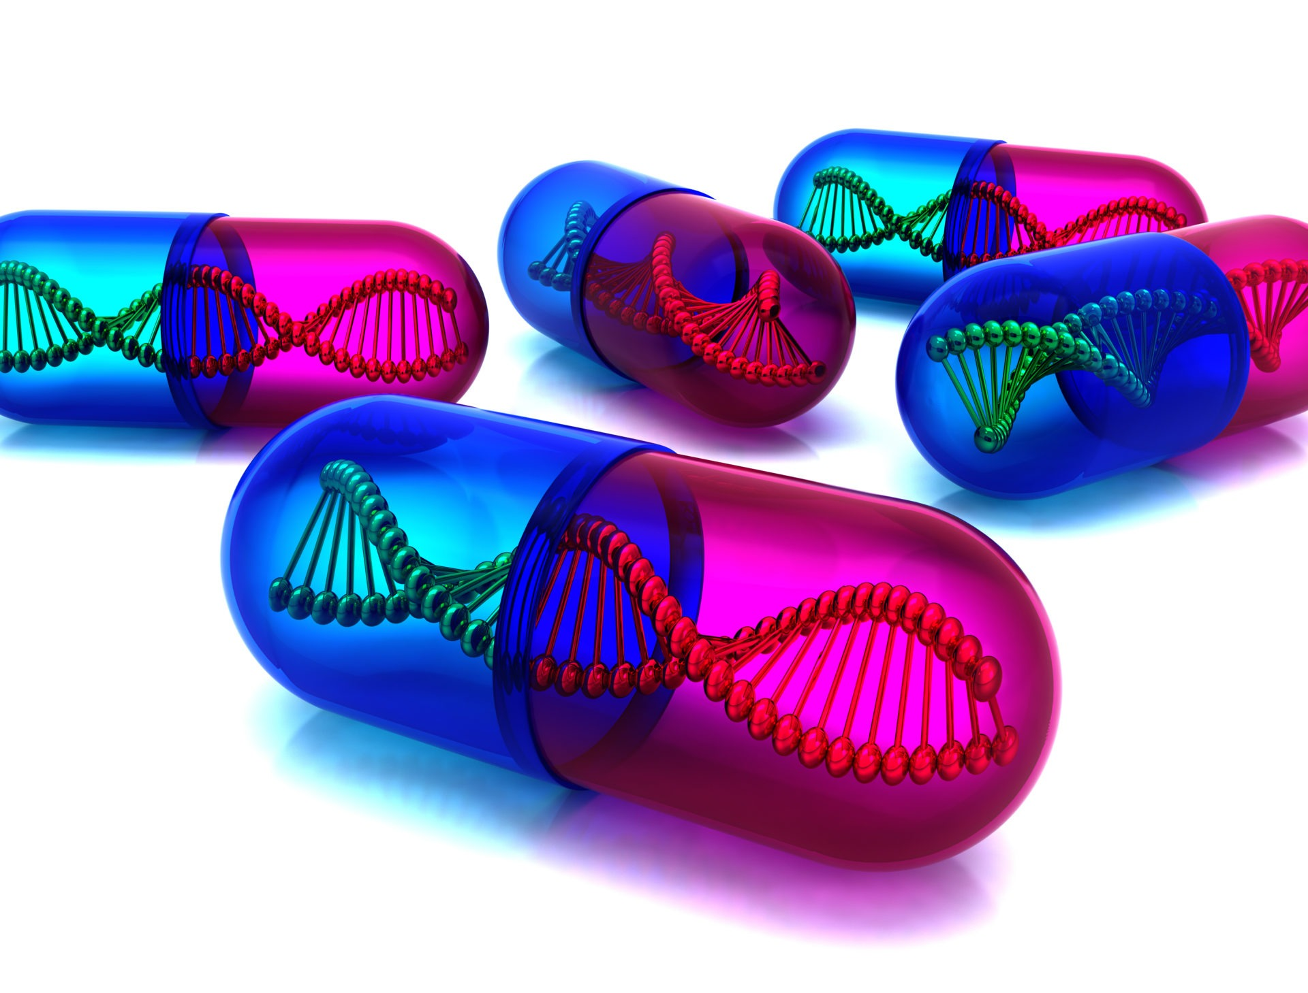
PHARMACOGENOMICS
BY
DR.G.AARTHIPRIYANKA
POST GRADUATE
DEPARTMENT OF PHARMACOLOGY

Slide 2
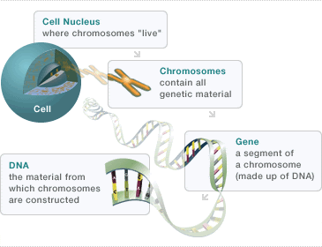
PHARMACOGENETICS
1
The study of the genetic basis for variations in drug response.

Slide 3
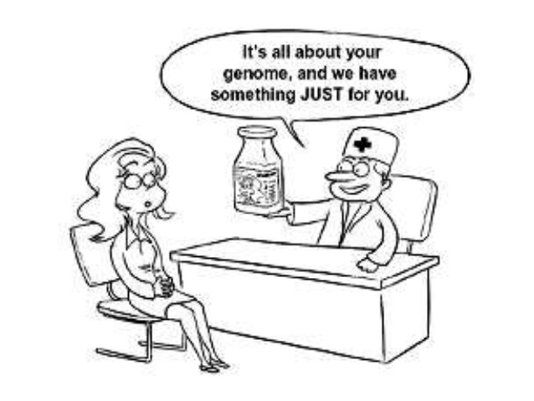
PHARMACOGENOMICS
2
Application of various tools for surveying the entire genome to assess multigenic determinants of the drug response, that becomes helpful in guiding the choice of drug and dose on individual basis.

Slide 4
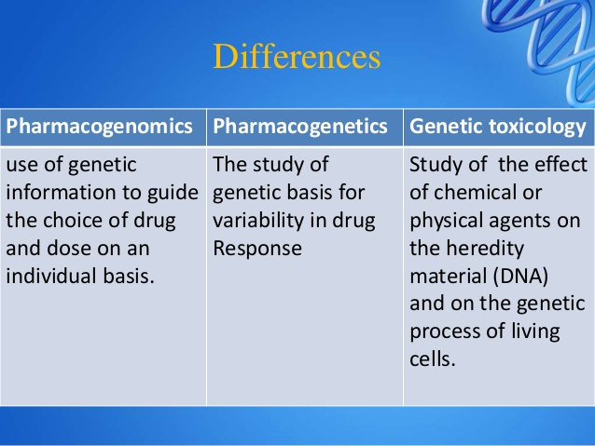
DIFFERENCE
3

Slide 5
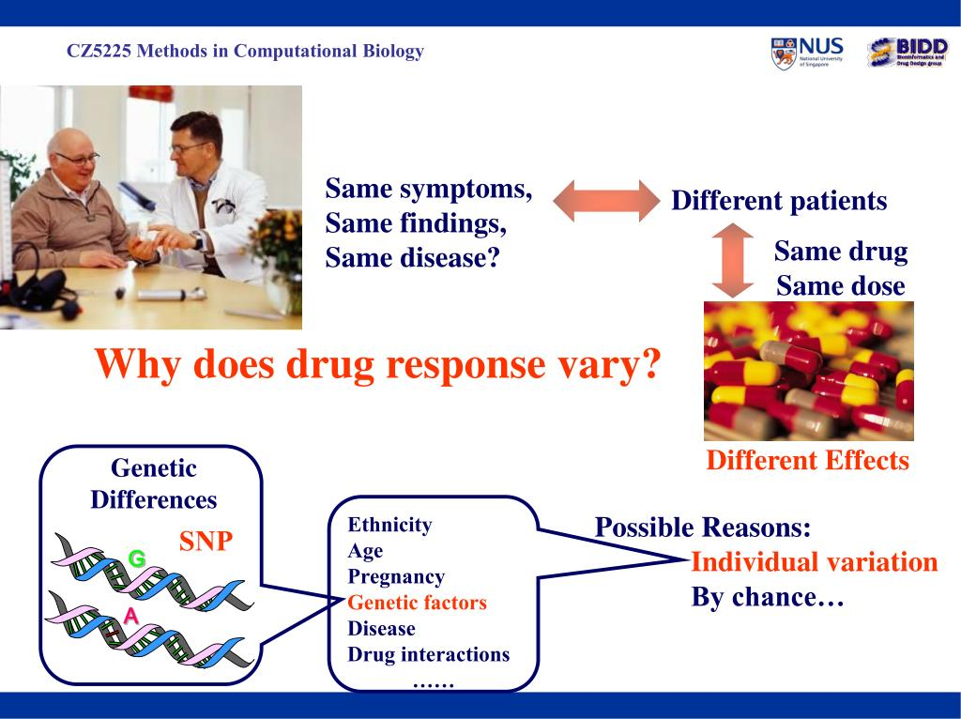
WHY ? ? ? ? ? ?
4

Slide 6
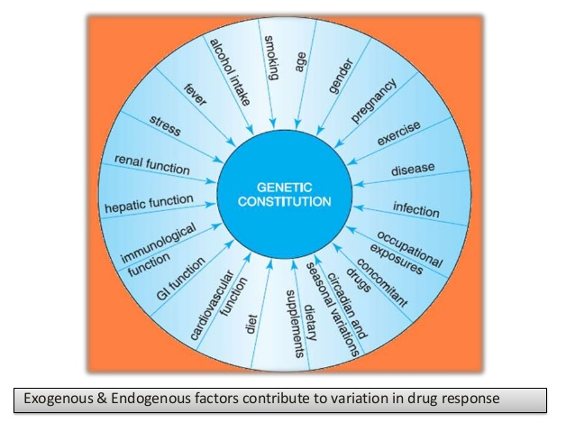
VARIATION IN DRUG RESPONSES
5

Slide 7
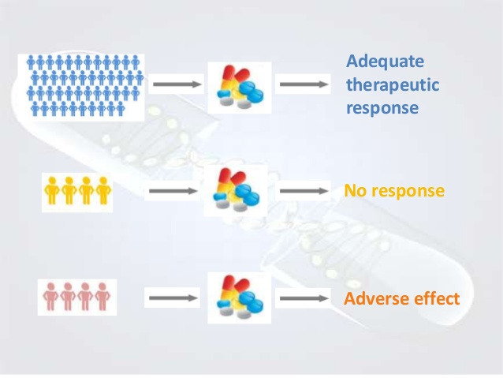
DIFFERENT EFFECTS
6

Slide 8
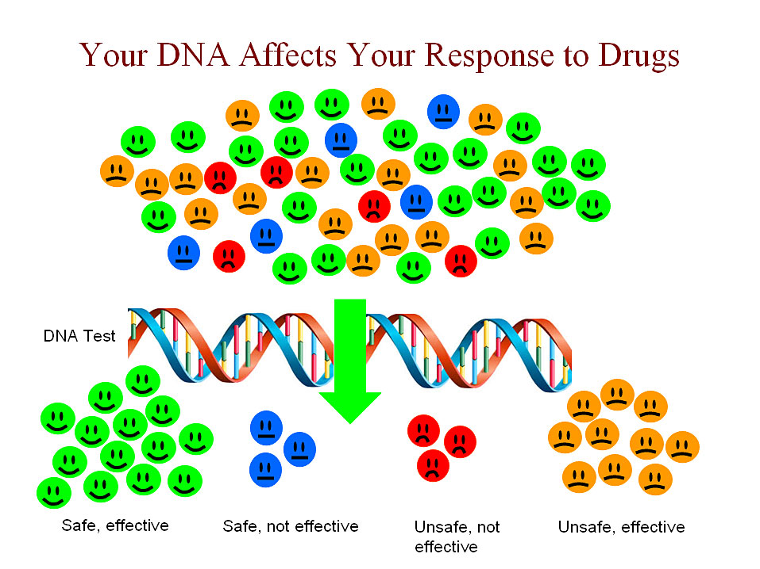
7

Slide 9
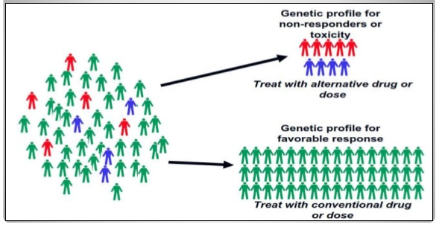
8

Slide 10
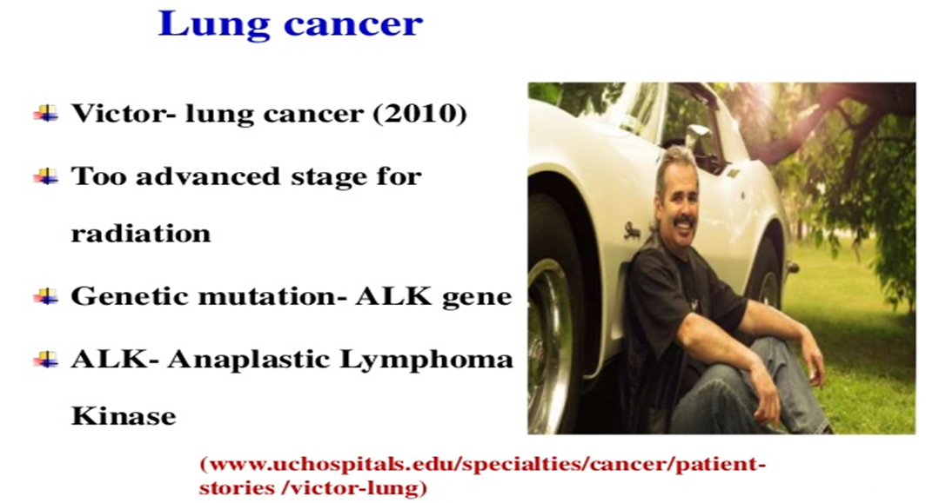
9
Notes:
Signal transduction pathways

Slide 11
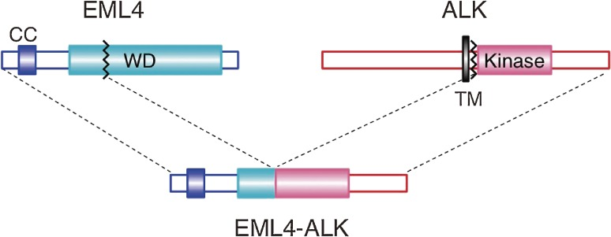
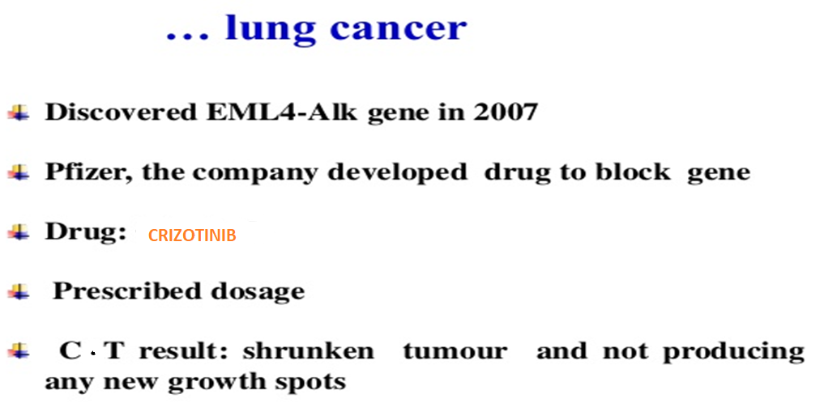
10
Notes:
Echinoderm microtubule associated protein like4-younger,light/non smokers.

Slide 12
HISTORY
11
The concept of an altered response based on genetic background is not new.
In 510 BC, Pythagoras recognized that some individuals developed hemolytic anemia with fava bean consumption (Nebert 1999).
Hemolytic anemia due to fava bean consumption was later determined to occur in glucose-6-phosphate-deficient individuals (Mager et al. 1965; Podda et al. 1969).
The term pharmacogenetics was first used by Friedrich Vogel in 1959. The dawn of pharmacogenetics continued by combining Mendelian genetics with observed phenotypes.
The application of biochip and microarray systems in pharmacogenomics is discussed by Jain (2000).
Notes:
Pentose phosphate pathway.glucose to ribose-5-phosphate.NADPH.red cells are susceptibile to damage by reactive oxygen species.

Slide 13


CPIC GUIDELINES
12
Clinical Pharmacogenetics Implementation Consortium (CPIC) published a series of guidelines for using genetic information in selecting medications and in dosing. These highly informative guidelines are being used by practitioners in prescribing drugs, to more effectively treat patients.
Pharmgkb.org

Slide 14
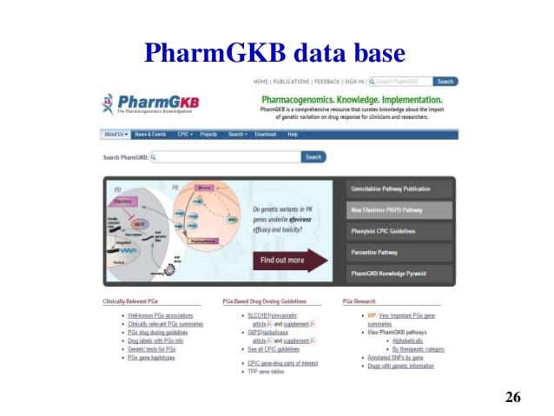
13

Slide 15
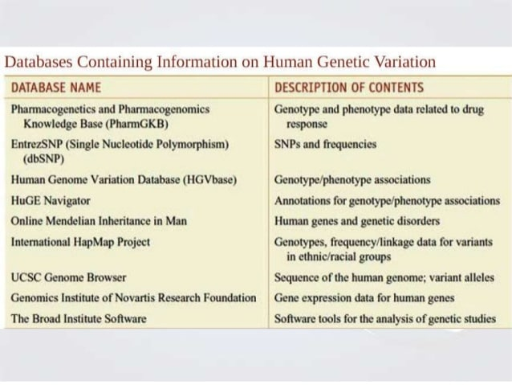
14

Slide 16
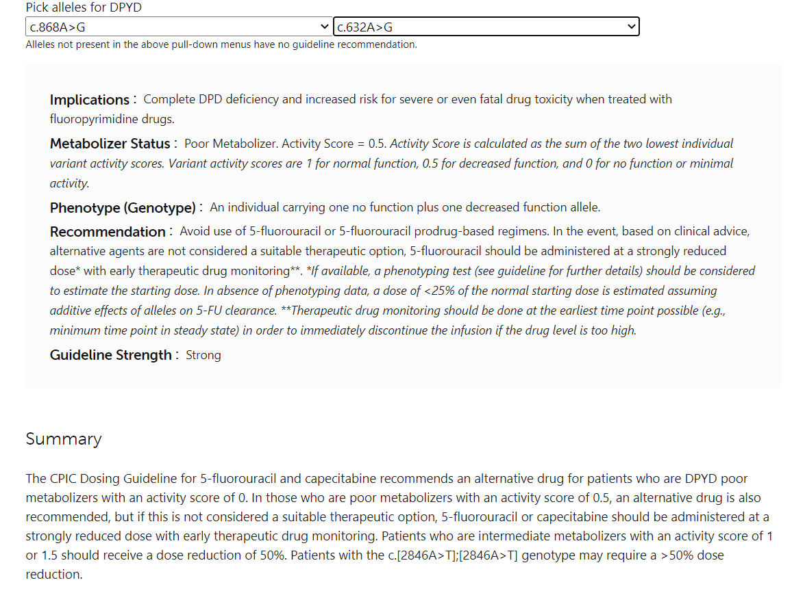
15

Slide 17
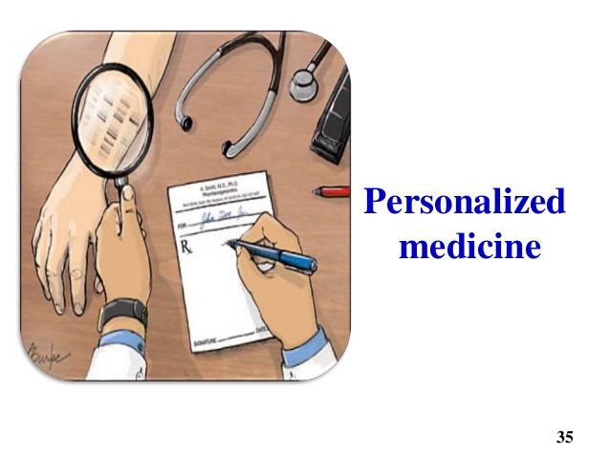
PRIMARY AIM
16
To identify which of these variants or combination of variants have functional consequences of the drug effects
GOAL: ersonalized medicine’

Slide 18
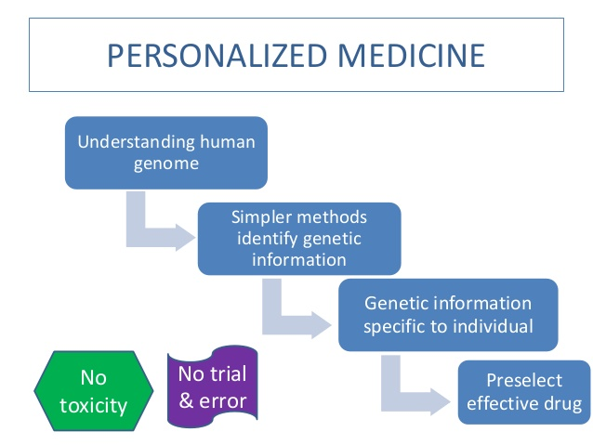
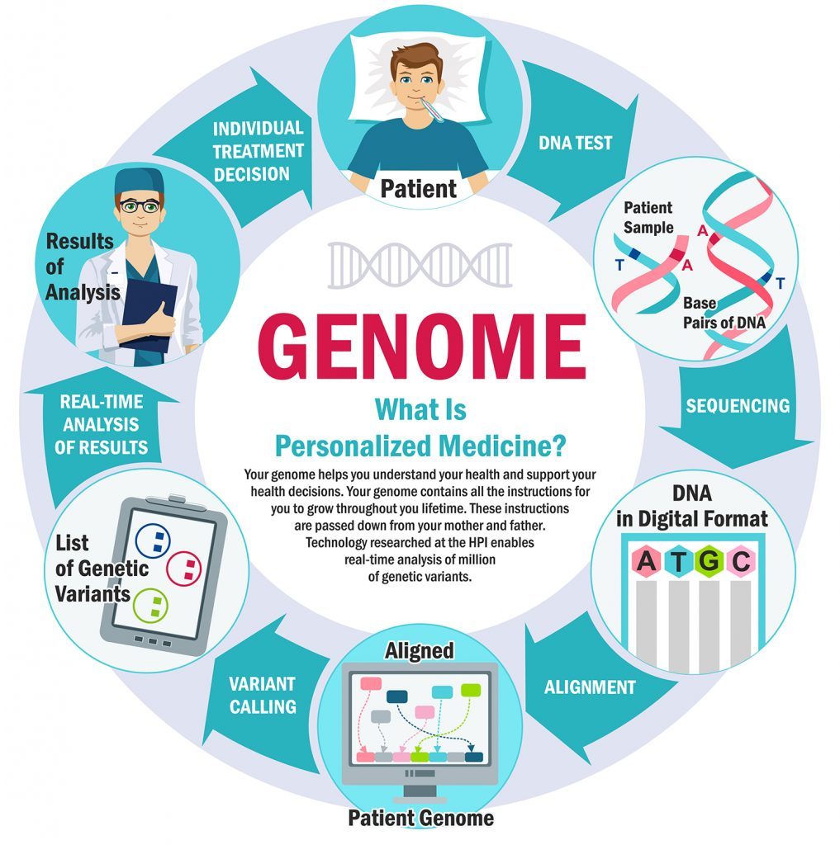
17

Slide 19
CAN WE PERSONALIZE ALL DRUGS?
18
Only these drugs can be personalized
Prodrugs
Drugs with a narrow therapeutic index
Drugs that target a key molecule or a critical pathway

Slide 20
HURDLES IN THE PATH
19
A large proportion of genetic variability is still unclear.
Cost of genetic study is the burden for the application.

Slide 21
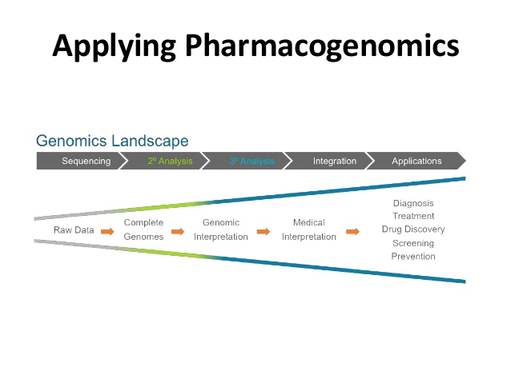
20

Slide 22
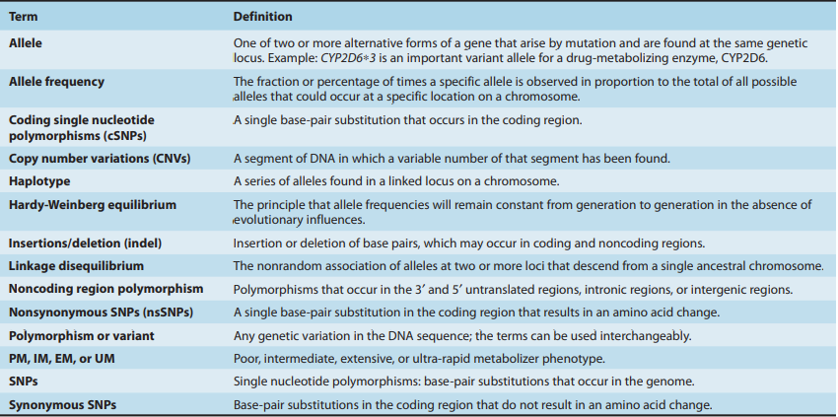
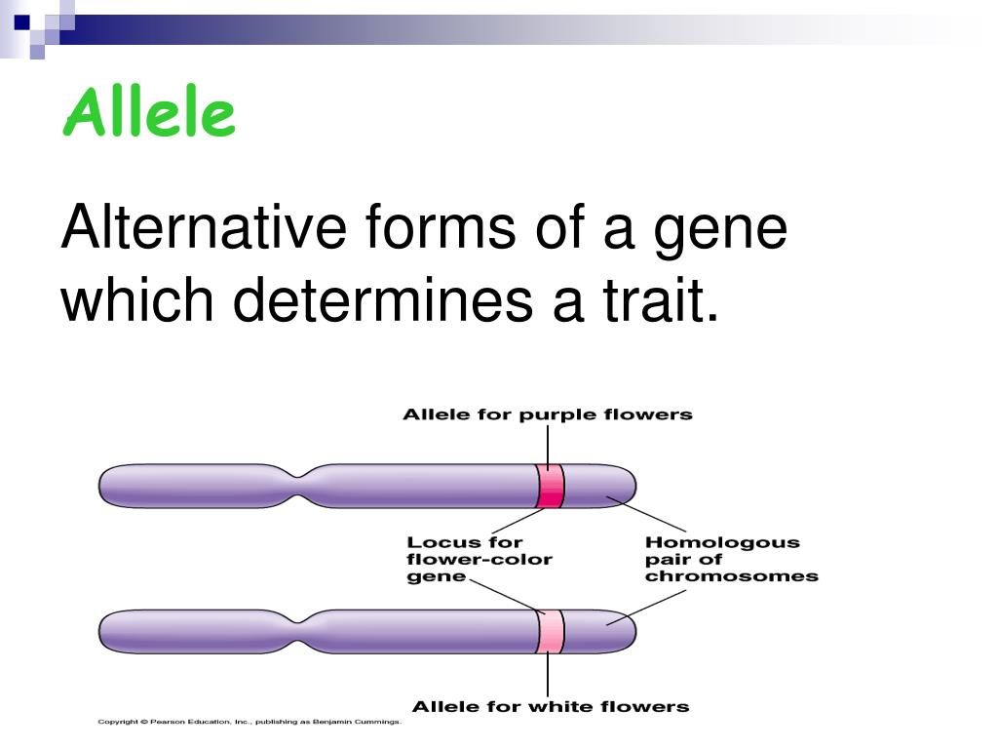
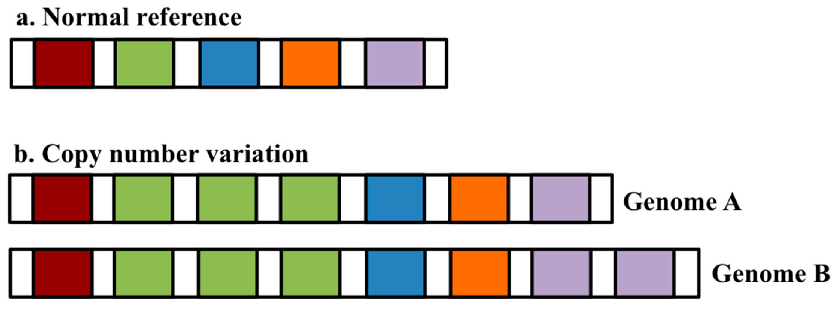
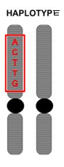
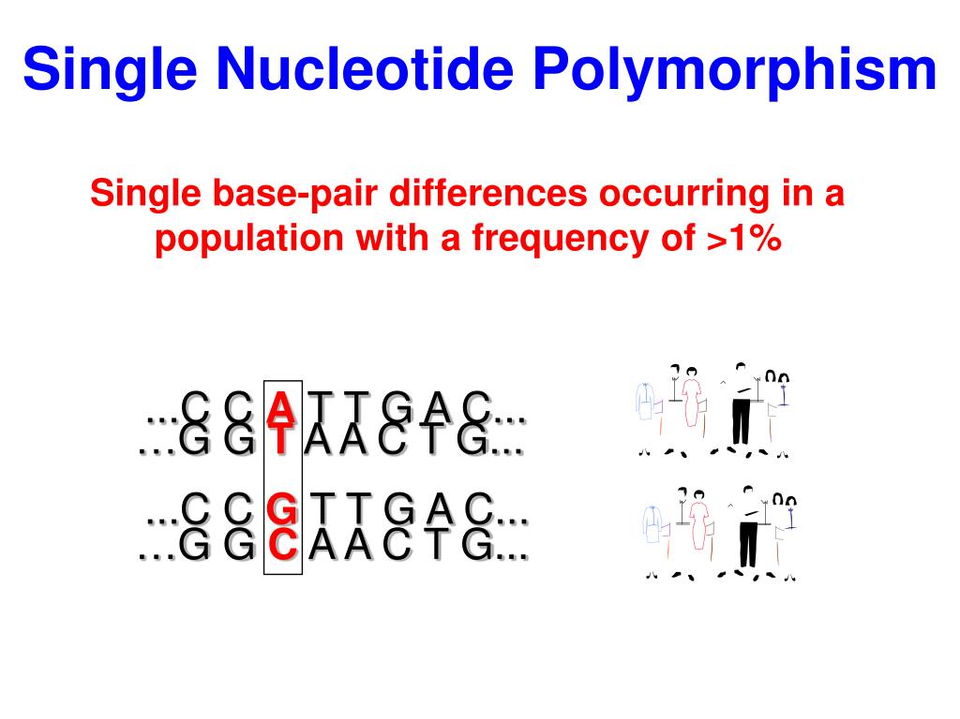
GLOSSARY
21

Slide 23
GENETIC VARIABILITY
22
Genetic variability of drug responses could be due to
Single gene mutation.
Polygenic mutation.

Slide 24
SINGLE NUCLEOTIDE POLYMORPHISM
23
Notes:
<1%-mutation.variance in DNA sequence such as deletion,insertion,duplication,substitution in one or more nucleotides,fixed.
SNP is type of mutation.not all mutations are SNP.

Slide 25
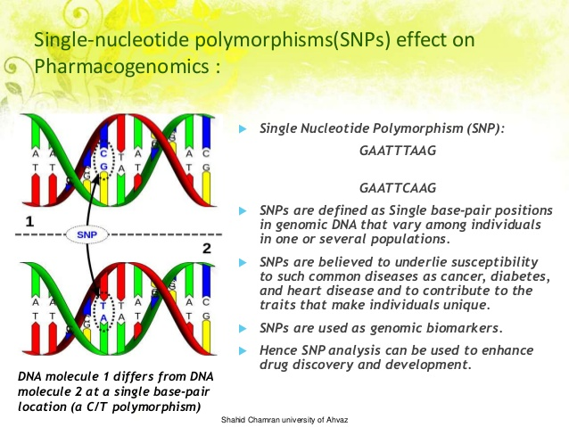
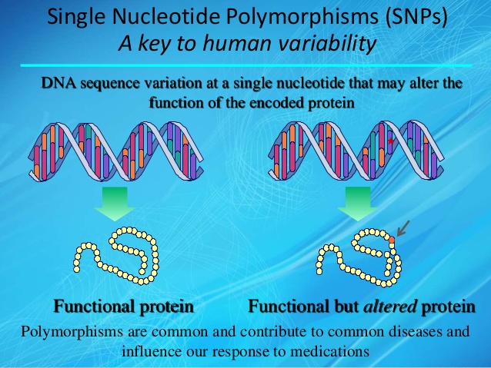
24

Slide 26
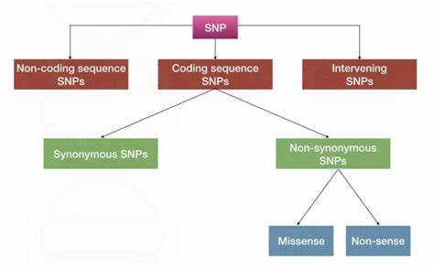
25

Slide 27
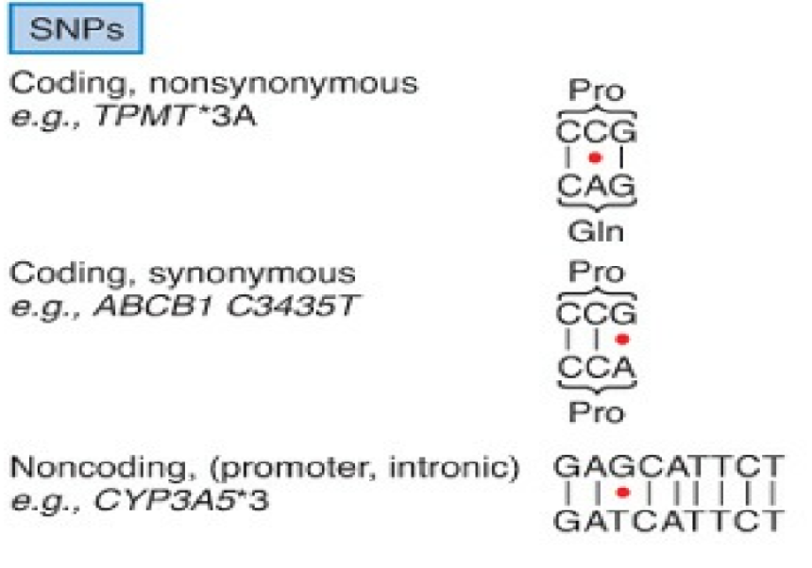
26

Slide 28
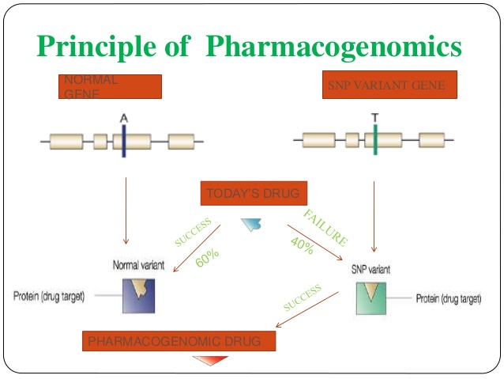
27

Slide 29
CLASSIFICATION OF VARIANTS
28
These genetic defects leads to variation of drug responses which can be classified on the basis of
PHARMACOKINETICC(drug disposition)
PHARMACODYNAMIC property of the drug.

Slide 30
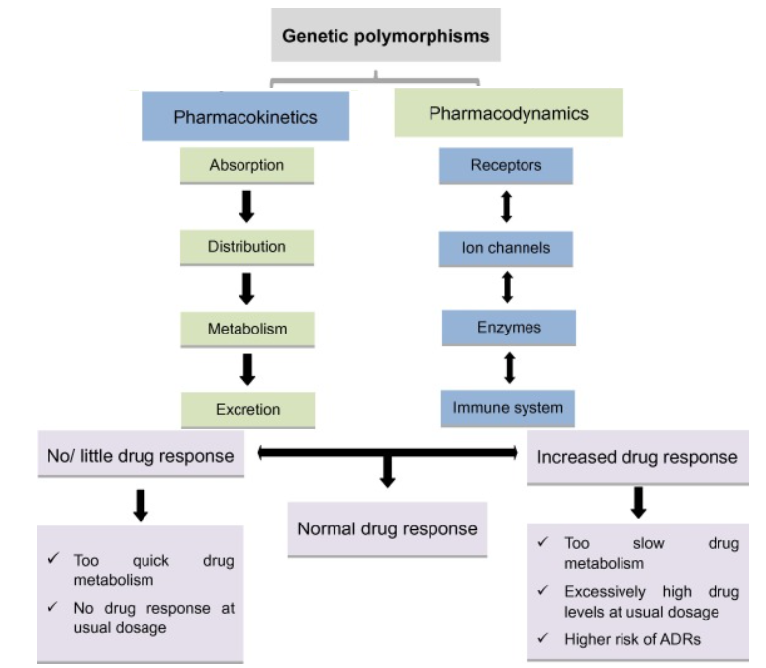
29

Slide 31
PHARMACOKINETIC VARIATIONS
30
Among the drug-metabolizing enzymes,
three clinically important isoforms of cytochrome P450,i.e.,
CYP2D6
CYP2C9
CYP2C19
(which contribute to the metabolism of 40% of the overall marketed drugs)
are identified possessing a large number of functionally significant genetic polymorphisms.

Slide 32
PHARMACODYNAMIC VARIATIONS
31
Genetic polymorphism that may alter the function of certain receptor and channel.
variations may lead to increase or decrease drug function.

Slide 33
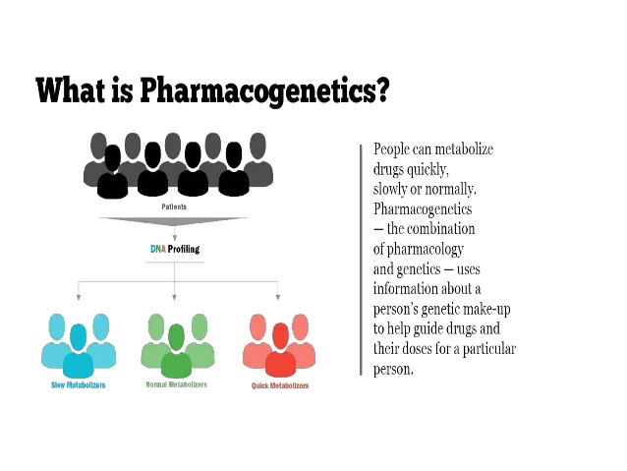
METABOLIZERS
32
Drugs that are inactivated by a certain polymorphic drug metabolizing enzyme and according to this individual are classified into
POOR METABOLIZER’S – reduced enzyme efficacy, increased risk of adverse drug reactions/toxicity
ULTRA-RAPID METABOLIZER’S – increased enzyme efficacy, increase chance of therapeutic failure

Slide 34
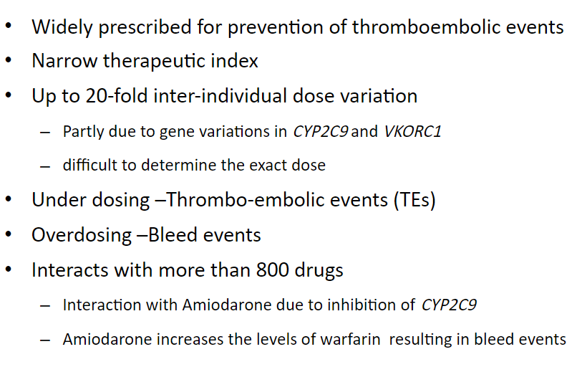
33
WARFARIN
Notes:
Wisconsin alumni research foundation-coumarin,tonka beans(cumaru)

Slide 35
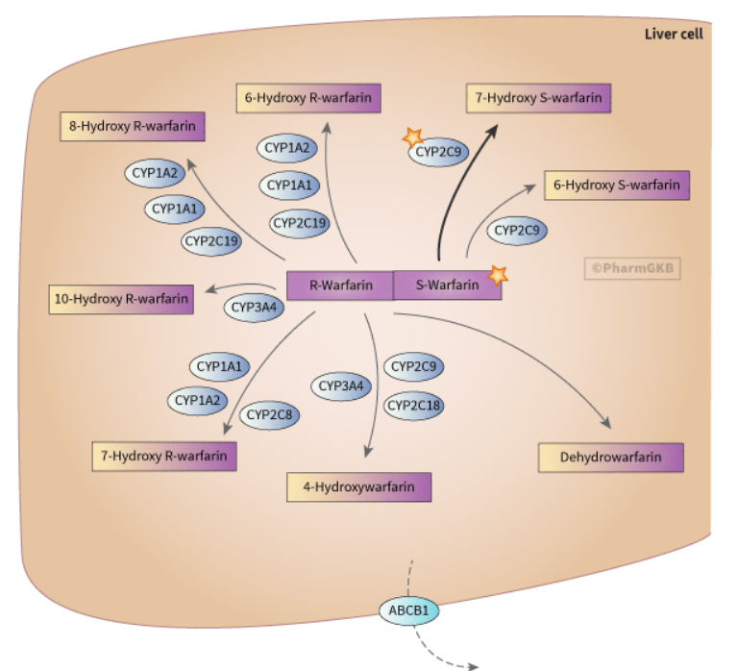
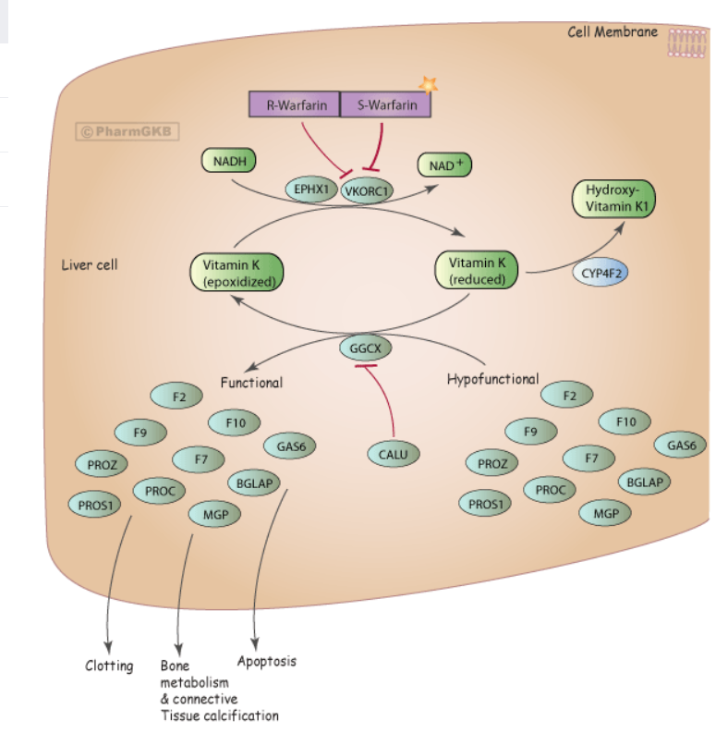
WARFARIN
34

Slide 36
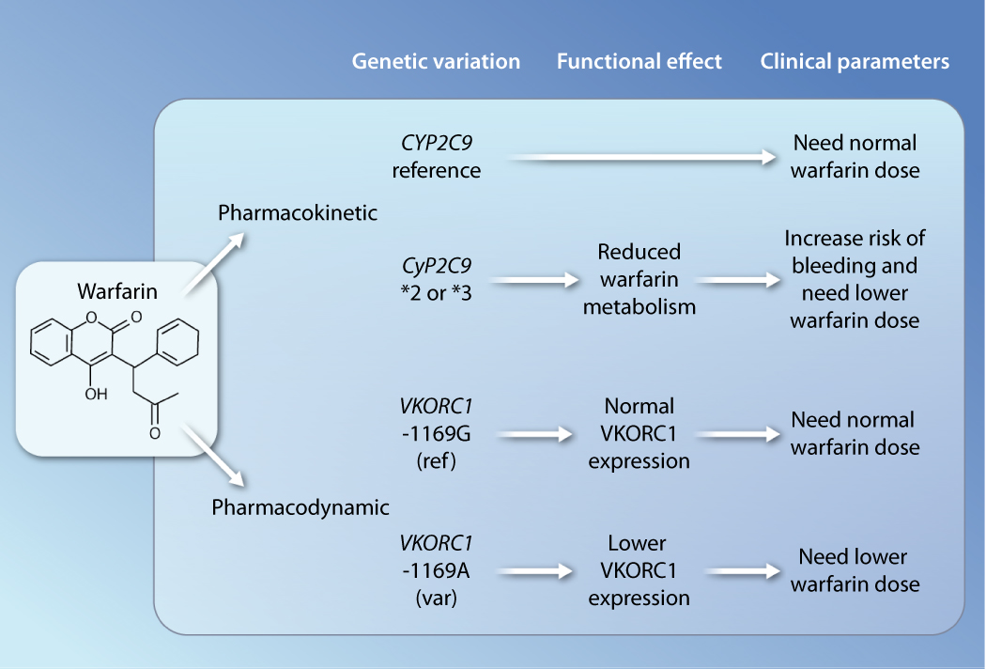
35
Notes:
Inr>8

Slide 37
WARFARIN
36
The target protein for warfarin
vitamin K epoxide reductase complex 1 (VKORC1).
For the target gene of VKORC1,
10 common polymorphisms have been identified in its promoter region
5 major haplotypes have been detected.
haplotypes group A - low dose requirement of warfarin,
haplotypes group B - high dose requirement.

Slide 38
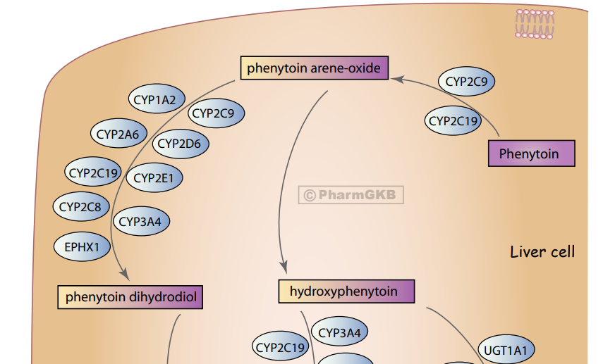
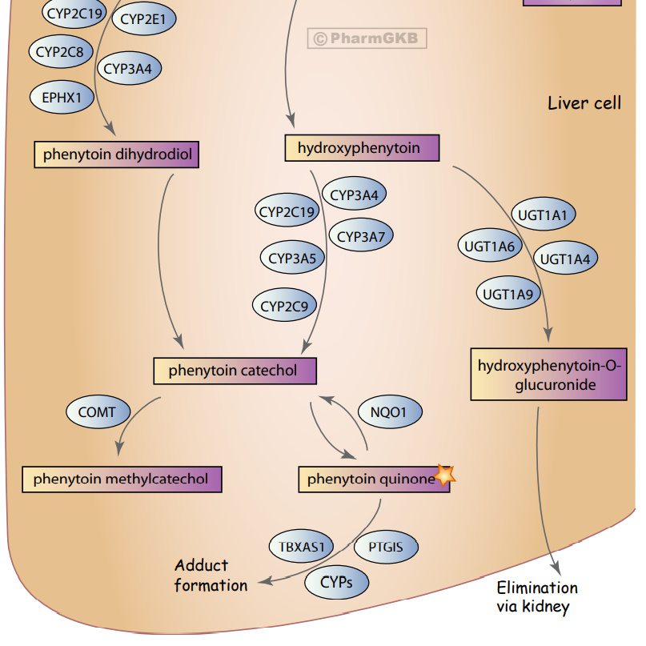
37
PHENYTOIN
Notes:
Narrow therapeu index.diphenyl hydantoin

Slide 39
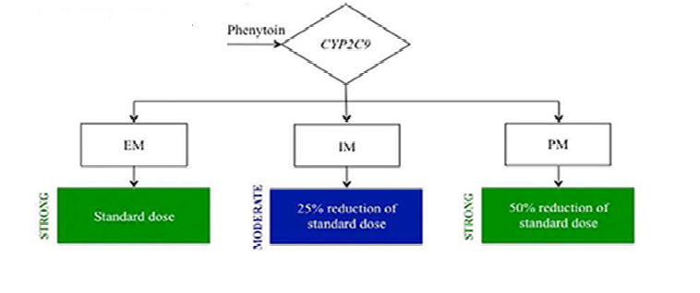
PHENYTOIN
38
Extensively metabolized in liver by CYP2C9.
CYP2C9*3 or CYP2C9*6
markedly impaired metabolism after taking a usual dose
severe phenytoin toxicity
Notes:
10-20mcg/ml,>20-nystagmus,>30-ataxia,>40-c0nfusion,>50-seizure,toxicity treatment-ffp

Slide 40
PHENYTOIN/CARBAMAZEPINE
39
The functional polymorphism in the SCN1A gene (sodium channels in neuron) (IVS5-91 allele)
markedly reduced phenytoin dose required.
Similarly, the SCN1A IVS5-91 G allele
significantly reduced carbamazepine doses.
Notes:
Sodium votltage gated channel alpha subunit 1

Slide 41
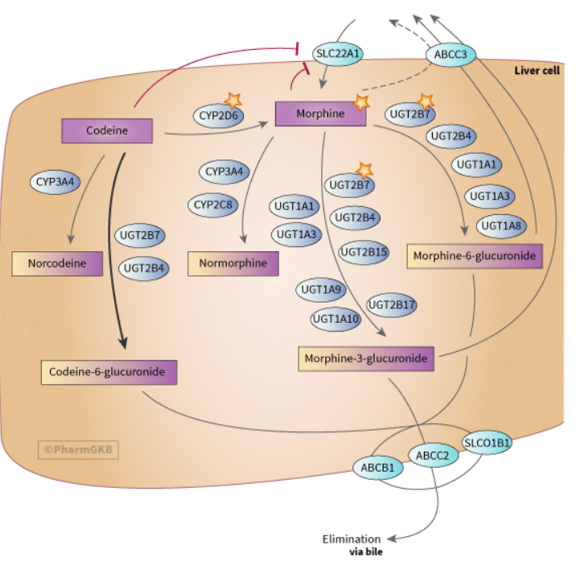
CODEINE
40

Slide 42
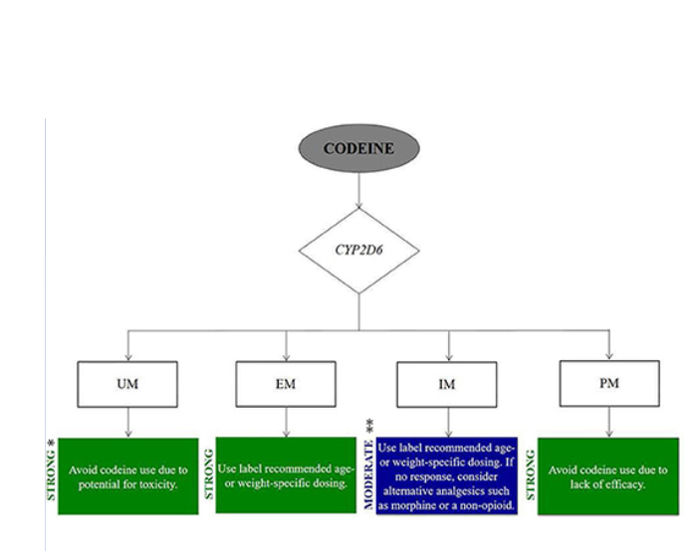
CODEINE
41
Metabolized by CYP2D6-mediated O-demethylation to generate pharmacologically active metabolite, MORPHINE.
CYP2D6 poor metabolizers – reduced analgesic effect of codeine.
CYP2D6 ultrarapid metabolizers – increased response of normal doses or severe toxicity.
Notes:
Resp. depression.usual dose-15,30,60mg,15 in 5ml spoonful.

Slide 43
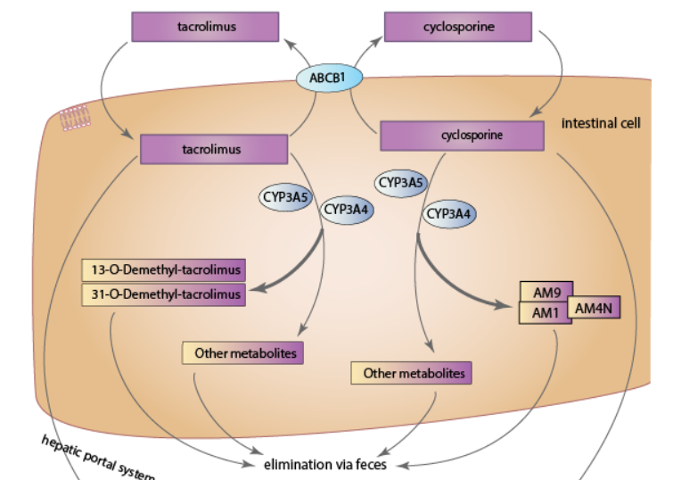
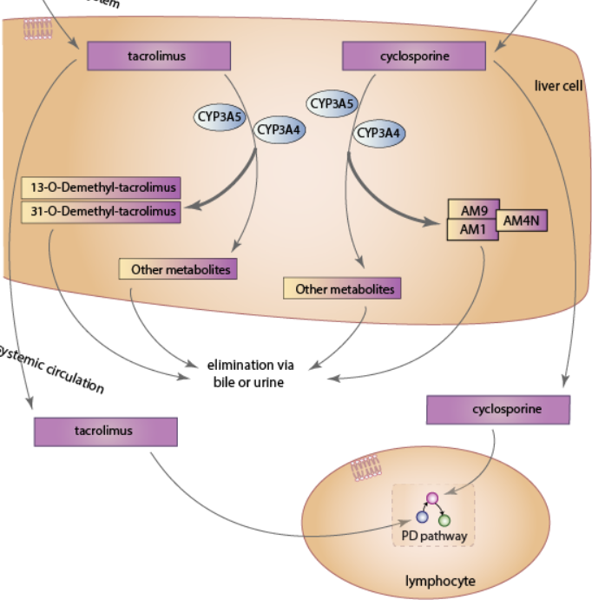
TACROLIMUS
42
CYP3A4/3A5/3A7 polymorphisms
poor metabolizers
drug toxicity.
Notes:
Tsukuba macrolide immunosuppressant.immunosup-organ trans,atopic dermatitis.
Calcineurin inhibitor.4%-Africa.80-90%[Caucasians),toxicity-acute renal failure.no treatment.level-5 to 15ng/ml

Slide 44
ISONIAZID-INDUCED NEUROPATHY/HEPATOTOXICITY
43
Polymorphism of N-Acetyl transferase(NAT2) enzyme causes slow/rapid acetylation.
In slow acetylators(around 60% of Indian) isoniazid gets accumulated in the body by daily dosing and may leads to peripheral neuropathy(by inhibiting pyridoxine kinase enzyme that produce active pyridoxyl phosphate from pyridoxine.
In rapid acetylators(around 40% of Indian) isoniazid gets metabolize faster, leads to higher concentration of acetyl hydrazine, a metabolizing product that cause hepatotoxicity.
Notes:
Isonicotinic acid derivative.inhibit bacterial cell wall formation.prodrug.

Slide 45
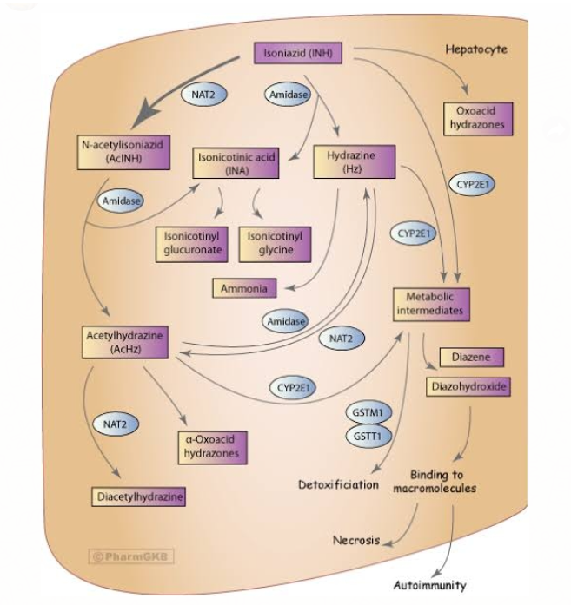
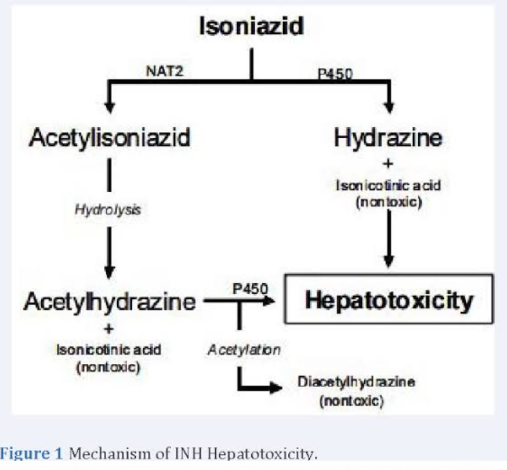
44
Notes:
Max dose:1gm/day

Slide 46
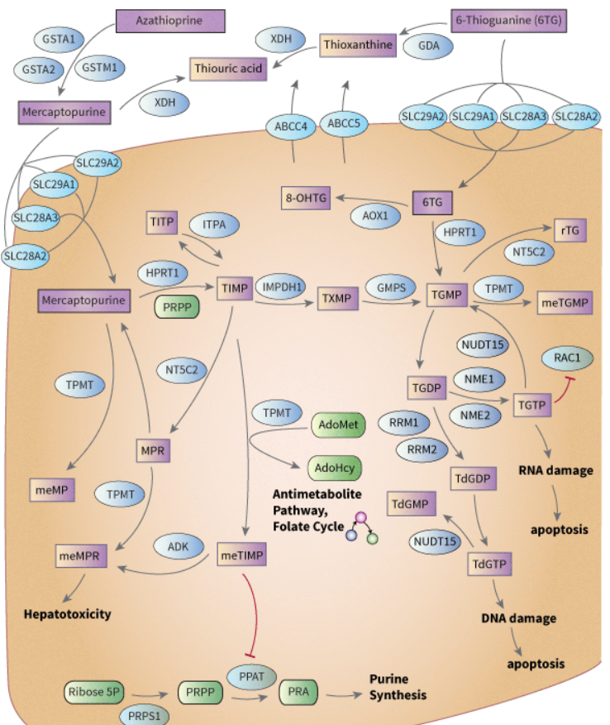
THIOPURINE DRUGS
45
The polymorphic thiopurine S-Methyl-transferase (TPMT) catalyzes the methylation of 6-MP and AZA (after the conversion of AZA to 6-MP).
In case of genetically deficient TPMT(TPMT*2,*3A and *3C),it causes increased production of 6-thioguanine nucleotides (6-TGNs) that exert therapeutic and toxic hematologic effects.
Low TPMT-Toxicity with standard dose.
High TPMT-undertreated.
Notes:
ALL,autoimmume,transplant reject.therapy incuced sec.leukemia,damage to bone marrow(haematopoietic toxicity).high TPMT>65U/ml,low<10.89% normal enzyme,11% low-caucasians

Slide 47
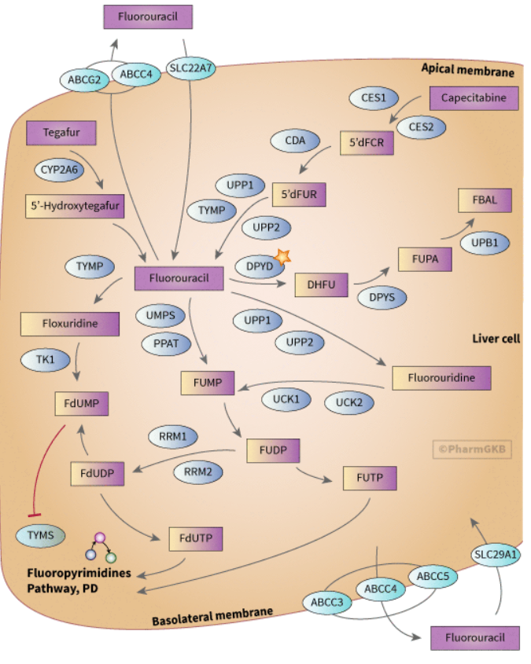
5-FLUOROURACIL/CAPECITABINE:
46
Dihydropyrimidine dehydrogenase (DPD) enzyme - DPYD gene,
rate-limiting step - pyrimidine catabolism
deactivates more than 80% of standard doses of 5-FU and the oral 5-FU prodrug capecitabine.
True deficiency of DPD- 5% of the overall population
lack of enzymatic activity - increases the half life of the drug
resulting in excess drug accumulation and toxicity.
3-5% of the population has a partial DPD deficiency
potentially limits their ability to fully metabolize the drug,
toxicity like severe (grade III/IV) and potentially fatal neutropenia,mucositis,diarrhoea.
Notes:
Fluorine atom on 5th carbon of uracil ring.Breast,colorectal ca.inhibits thymidylate synthase-no thymidine for DNA syn.di-warfarin,allopurinol.myelosuppression,hand foot syndrome-chemo induced acral erythema.

Slide 48
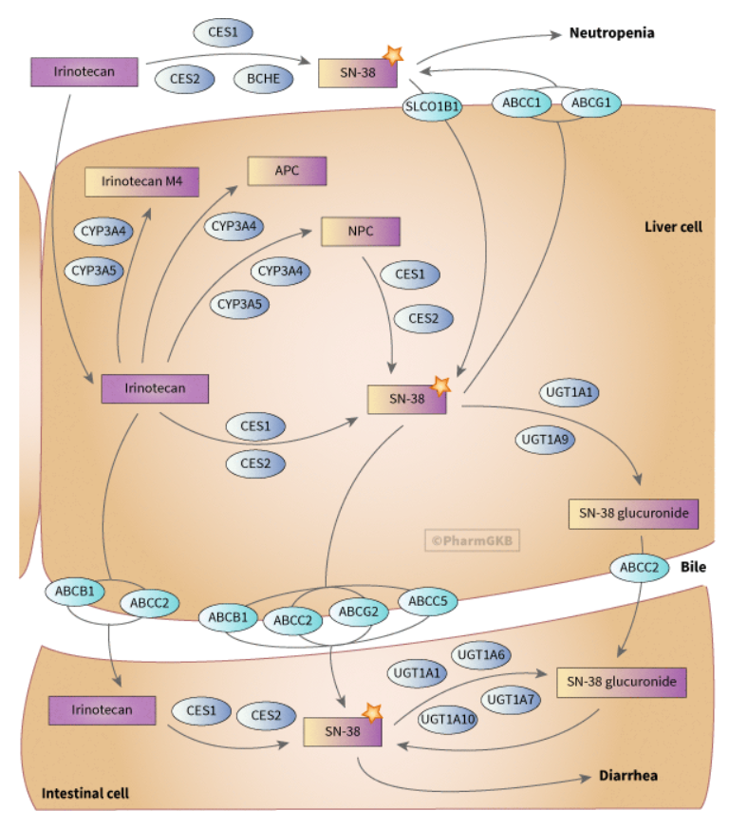
IRINOTECAN
47
The metabolite of irinotecan,i.e.,SN38,
eliminated by glucuronidation
lower UGT1A1 activity due to UGT1A1*28 allele,
leads to reduced transcription of enzyme
risk of toxicity.
Notes:
Colon ca with FU,SCLC-cisplatin.campothecin,plant alkaloid.topoisomerase inhibitor-tp1-damage DNA,cell death.URIDINE DIPHOSPHATE GLUCURONOSYL TRANSFERASE1,hepatic,extra hepatic
GILBERT SYN-AR,jaundice triggered by exercise,mensus,not eating.high levels of unconjugated bilirubin in blood,>250mg/m2,neutropenia,diarrhoea

Slide 49
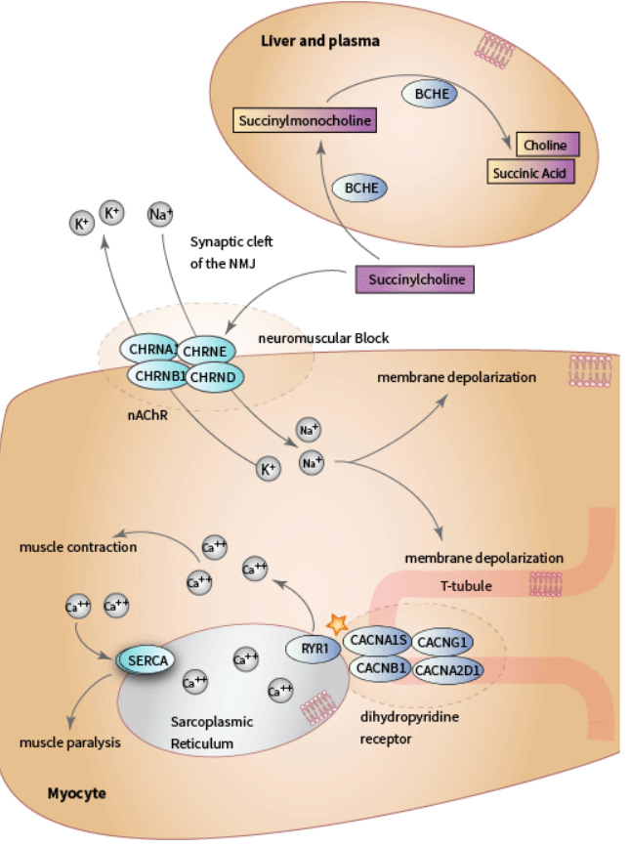
SUCCINYL CHOLINE
48
SUCCINYL CHOLINE: atypical pseudocholinesterase produces prolong apnoea
Notes:
4 allele-silent,usual,dubucaine,fluoride,absent.short duration is by rapid metabolism by plasma cholinesterase.atypical pc esterase-resduced in genetic variation.20 mins to several hours.

Slide 50
HALOTHANE
49
Malignant hyperthermia
abnormal calcium release from sarcoplasmic reticulum (SR)
due to ryanodine receptor mutation (of the three forms of the ryanodine receptor, RYR1, RYR2 and RYR3, only mutations in RYR1 have been linked to Malignant Hyperthermia).
Notes:
High fevet,muscle rigidity,fast heart rate-MH.new mutation with inherited muscle disease-centre core disease.treatment-propofol,ketamine,non-depolarising

Slide 51
TRASTUZUMAB & CETUXIMAB
50
The human epidermal growth factor receptor (HER2/ErbB2) gene is amplified in up to 30% of patients with breast cancer,
resulting in the over expression of the HER2 receptor protein.
target for the anti-HER2 monoclonal antibody that binds to the extracellular domain of EGFR
specifically block the EGFR-mediated signaling pathway, thus preventing ligand activation of the receptor.
Cetuximab has relatively little inhibition of EGFR-mutant cancer cells (mutation T790M in EGFR), because it is unable to inhibit phosphorylation of the mutant EGFRs.KRAS gene.
Notes:
Trast-breast/stomach ca.
Cetu-metastatic colorectal ca.chimeric monoclonal ab,which bind and inhibit EGFR.specificity in binding pocket
Her2-cell growth,arrest cell cycle at G1
T790M-THR replaced by methionine at a.a 790-gate keeper residue,key in determining specificity in binding pocket.
KRAS-small G protein on EGFR pathway.act on;y when KRAS not mutated

Slide 52
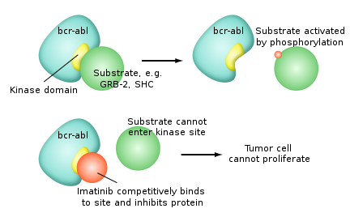
IMATINIB
51
Philadelphia (ph) chromosome translocation (t, 9;22), resulting in the production of the breakpoint cluster region-abelson fusion gene (an oncogene)
competitive inhibitor of ATP binding to the ABL kinase, a non-receptor tyrosine kinase,
thus inhibiting the constitutively activated BCR-ABL.
Mutations in the kinase domain of BCR/ABL
(including mutations E255K and T3151)
imatinib resistance.
Notes:
CML,ALL,GIST,HES.resistance-rapidly develop.

Slide 53
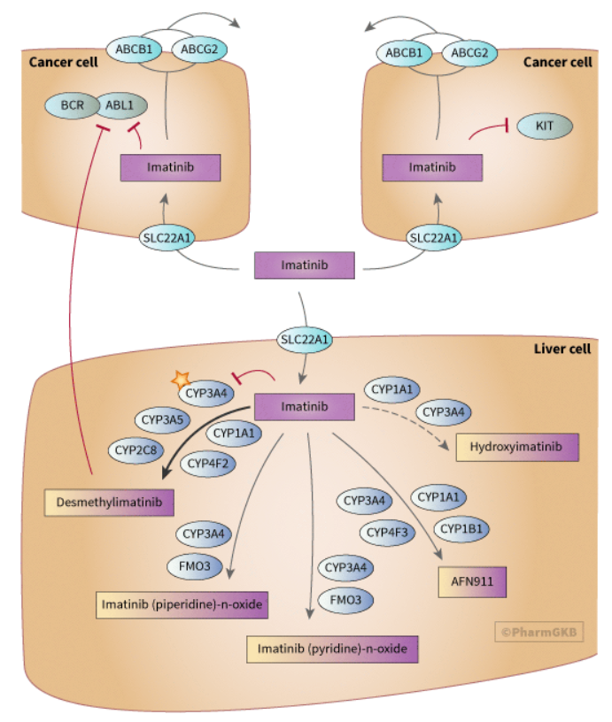
52

Slide 54
ERLOTINIB & GEFITINIB
53
Increased tyrosine kinase(TK) activity of the transmembrane epidermal growth factor receptor (EGFR)
proliferation and metastasis of tumour cells.
Gefitinib, a TK inhibitor, (first agents designed)
specifically inhibit the activation of TK activity of the EFGR
through the competitive binding of the adenosine triphosphate(ATP) binding domain of the receptor,
rremarkably rapid clinical response in a subgroup of patients with non-small cell lung cancer(NSCLC).
Somatic mutations, such as short,in-frame deletions(relatively common) and single amino acid substitutions(such as L858R),have been identified more frequently causing Erlotinib and Gefitinib resistance.
Notes:
Gefi-breast,lung cancers.resistance-ATP over gefi.
Erlo-NSCLC,pancreatic ca. resi-8 to 12 months after treatment.50%-T790M,20%-hepatocyte growth factor receptor

Slide 55


54

Slide 56

SALBUTAMOL
55
Beta2-Adrenergic receptor(by ADBR2 mutation)
increased cardiovascular effects of beta2 agonist.
e.g., increased heart rate is determined by
genetic polymorphism.

Slide 57

56

Slide 58
ERYTHROMYCIN,CISAPRIDE, CLARITHROMYCIN,QUINIDINE
57
Mutations in channels gene(HERG,KvLQT1,Mink,MiRP1 mutation) respectively.
increased risk of drug-induced torsades de pointes and increased QT interval.
Notes:
TDP-drug induced QT prolongation,diarrhoea,low serum mg,k,malnourished,alcohol.
Drug increase QT-phenothiazines,TCA,lithium

Slide 59
THE DOPAMINE D4 RECEPTOR
58
D4 receptor gene is an example of a receptor gene-drug interaction leads to toxicity.
Tardive dyskinesia (debilitating and potentially irreversible adverse effect)
25% of patient with first generation anti-psychotics like thioridazine or haloperidol.
Polymorphism of genes encoding for the dopamine D4 receptors- risk for tardive dyskinesia.
Notes:
Stiff jerky movements of body and face.treatment-valbenazine,deutetrabenazine.D2 like GPCR by DRD4 gene on chromosome 11.11p15.

Slide 60



59

Slide 61
STEPS TOWARD PERSONALIZED MEDICINE
60
Personalized medicine focuses on individualized drug treatment according to each patient’s molecular diagnosis and genetic makeup.
Individualized drug therapy involves appropriate drug selection and rational dosage adjustment to optimize therapeutic response.
These drugs can be personalized
Prodrugs
Drugs with a narrow therapeutic index
Drugs that target a key molecule or a critical pathway

Slide 62
61
Drug safety is always the area of primary concern, in which patients can benefit from pharmacogenetics and pharmacogenomics.
Tumour responses to the inhibitors of oncogenic tyrosine kinases are associated with the presence of activating mutations within the genes encoding the target kinases, targeted cancer therapy is therefore a promising individualized drug therapy.

Slide 63


ROCHE AMPLI CHIP CYP450 ARRAY
62
This was designed to analyze two genes, CYP2C19 and CYP2D6, that encode drug-metabolizing enzymes involved in the metabolism of approximately 25% of all prescribed drugs.

Slide 64

63

Slide 65
CHALLENGES
64
The response of particular drug is effected by multiple factors, a single genetic variation is only one of them
A particular genetic variant may increase the chance of a certain adverse reaction or toxicity of a drug but it is not the rule always, as the effect of the drug affected by multiple factor including food,environment,interaction with other,etc.As a result, genetic variant may not always experience a certain adverse reaction to a particular drug, though it is theoretically possible.

Slide 66
65
CHALLENGES – Contd.
A number of interacting genetic and environmental factors that may influence the response to a drug.
Lack of suitable test to detect the genetic variation.
If test is available then its cost-effectiveness may be a burden in implementing such as routine care in country like India.
Regulatory agencies should construct regulation to assess, consider and license pharmacogenetic products.
Exploring sensitive information on someone’s genetic makeup and data sharing may rise privacy, security and ethical issues
Notes:
GINA – Genetic information Non-discrimination Act-2008,prevents discrimination from health insurers and employers,americans from being treated unfairly.

Slide 67
66
CHALLENGES – Contd.
Reimbursement pathway of such testing is not established.
Clinicians not always aware of tests availability, associated drugs and their outcome, i.e. about core pharmacology.
Finally, the field of pharmacogenomics is still in its infancy. Till now there is limited knowledge about gene-drug interaction.
Notes:
Act of compensating for an out of pocket expense-reimbursement

Slide 68

67

Slide 69

68

Slide 70

69

Slide 71

SCOPE OF PHARMACOGENOMICS
70

Slide 72

71

Slide 73

72

Slide 74



